Slide 1
6G4Z0024 Web Development Lecture 2: HTML forms and Introduction to Styling
Yanlong Zhang
Y.Zhang@mmu.ac.uk

Slide 2
Learning Objectives
To understand what HTML forms are and why we use them
To understand the basics of CSS
Formatting
Layout

Slide 3
Last week recap
The web works on a client-server architecture. What does this mean?
Websites mostly consist of HTML pages. What is HTML?
HTML is made up of elements. Elements instruct the browser to display different things on the screen. Elements may be nested or even self-closing.
What are attributes?
Notes:
Attributes provide additional information, always specified in the start tag, and usually come in name/value pairs

Slide 4
Crib sheet
HTML4 tags
p <h1>-<h6> br hr span &nbsp
img
a
ol ul li
table tr th td
div
HTML5 tags
video audio
header nav article section aside footer

Slide 5
HTML Forms
Html tags and attributes
form
label
input
select

Slide 6
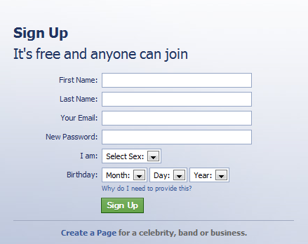
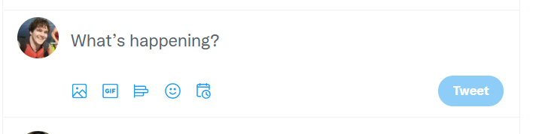
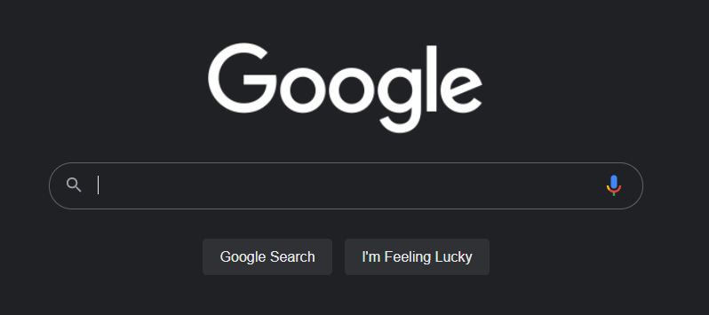
Anything that requires user input!

Slide 7
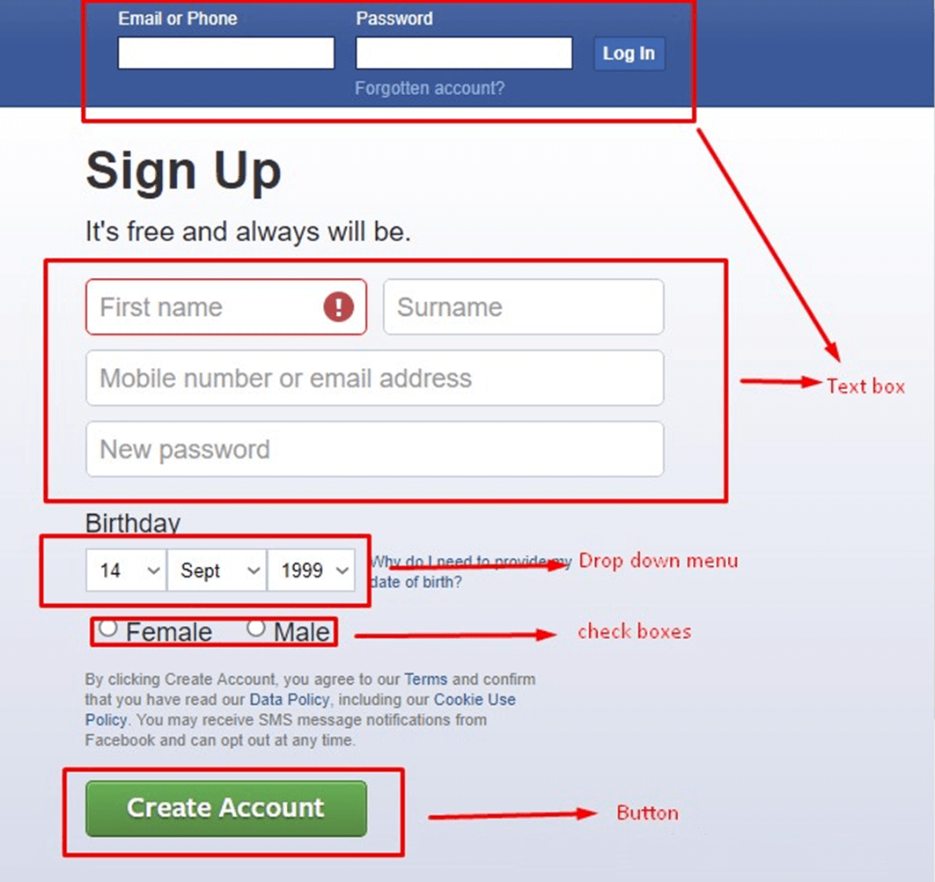
Forms are made up of different types of inputs

Slide 8
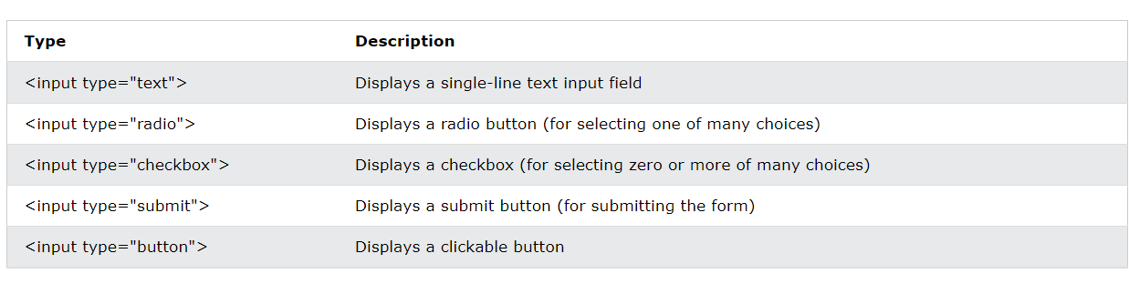
Forms in HTML
Forms are wrapped in the <form> element
Contain multiple input elements

Slide 9
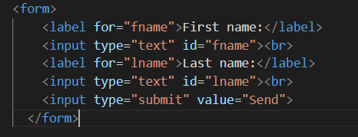
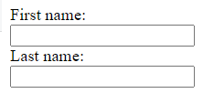
Simple form example
Labels are provided for each input and linked using the attributes “for” and “name”
Each input is given an ID so that it can be identified later in code
The type attribute denotes that the inputs will be text inputs
What’s the <br /> for?

Slide 10
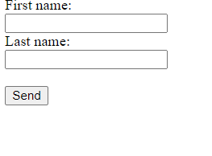

Actioning forms
Entering inputs is pointless unless it does something
We will look at what we can do with form inputs later in the course
Most forms work by clicking some kind of “submit” button to start an action

Slide 11
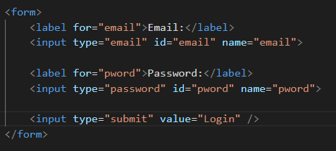

Another example
Note that both inputs are still text inputs
However, HTML includes special inputs to provide extra layers of validation
We’ll look more at validation later

Slide 12
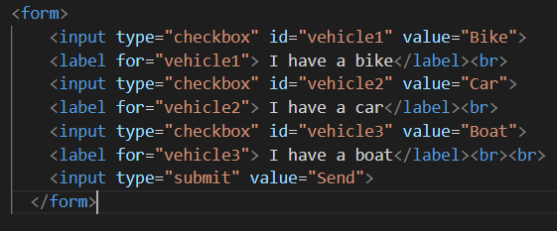

Other types of inputs: Checkboxes
Allows us to select multiple options

Slide 13
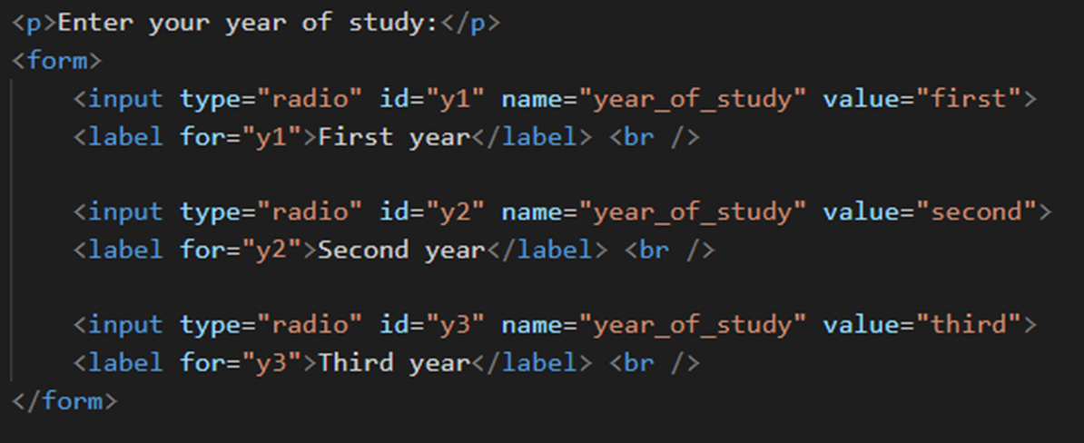
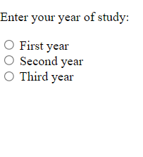
Other types of inputs: Radio Buttons
Allows us to select from a list of options

Slide 14
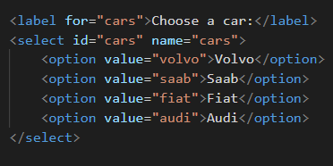

Other types of inputs: Drop downs
Allows us to select from a list of options

Slide 15
Other attributes
There are a lot of additional attributes that you can use within forms:
Make the form more user friendly
Prompt the user to enter the correct data
Enforce correct data entry as a layer of validation

Slide 16
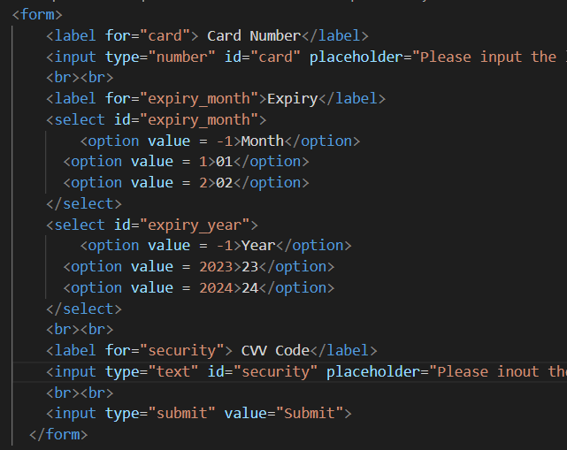
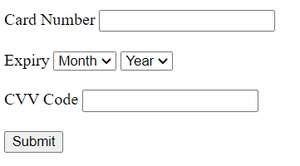
form revisited
The placeholder attribute gives some prompt text up front
The required attribute forces the user to enter a value before submitting the form
The autofocus attribute specifies that the cursor should start there when the page

Slide 17
Adding style!
For adding styles to our websites, we use CSS
CSS stands for Cascading Style Sheets
CSS describes how HTML elements are to be displayed
CSS can control the layouts of multiple web pages at once (saving a lot of work)
We store our CSS in external .css files which we link to our HTML pages.

Slide 18
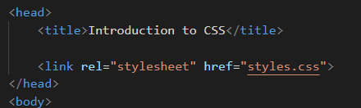
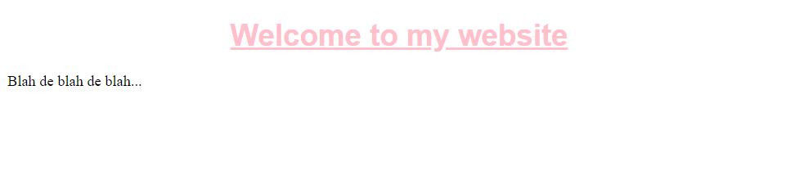
Linking our CSS to our HTML
Use the HTML <link> element
Two attributes: “rel” and “href”
In the <head> section of your HTML page

Slide 19
Why do we use CSS?
We can define our styling in one place, and know that it is implemented the same throughout our website
Separates the look of the website from the content (HTML). Easier to maintain and manage

Slide 20
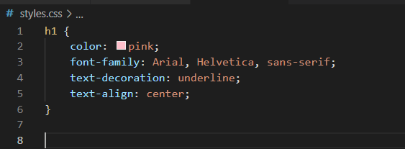
CSS Syntax
h1 – selector (what we are styling)
Inside the curly brackets we have four declarations, separated by semi-colons
Each declaration consists of a property and a value
Any other selector?

Slide 21
IDs and Classes
We can identify areas of our HTML using IDs and classes
Providing an element with an ID allows you to find a single element within the page. The ID must be unique to a single element
Classes on the other hand can be used on multiple elements to share styles across your HTML page
Let’s look at an example…

Slide 22
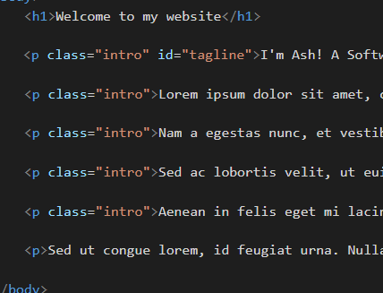
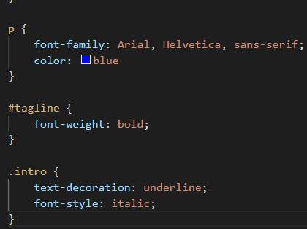
IDs and classes example

Slide 23
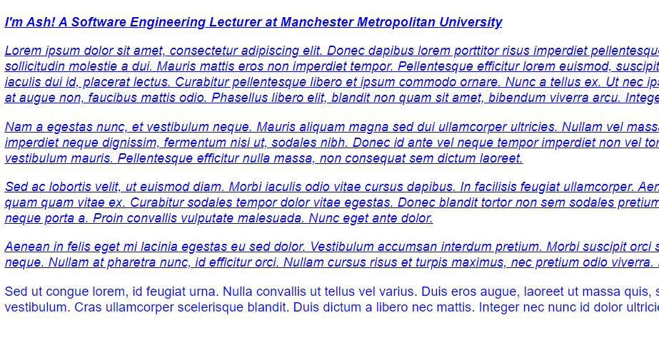
IDs and classes example
All paragraphs adopt the .p style (blue and Arial)
Those with the intro class are underlined and italic
The tagline paragraph is also in bold

Slide 24

Overwriting styles
Adding !important to the end of a style declaration will override all previous styling rules for the property

Slide 25
The <div> element or HTML5 semantic tags
The <div> / HTML5 tag allows us to define sections of our web pages
It is usually used as a container for other elements
We can use it to start building layouts
Let’s have a look…

Slide 26
Layout example
Imagine we are designing a blog, and want to have the layout drawn here
Header and navigation
Left column, more navigation
Main Content
Footer

Slide 27
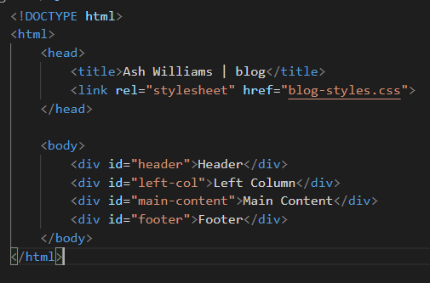
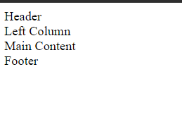
The HTML is pretty simple…

Slide 28
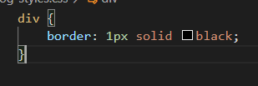
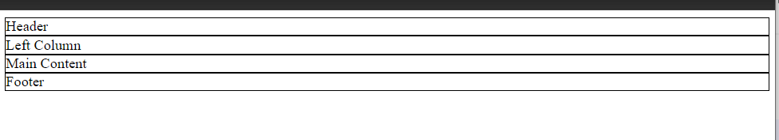
First, let’s give all divs a border so that we can see them better

Slide 29
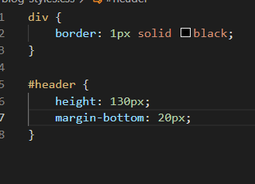
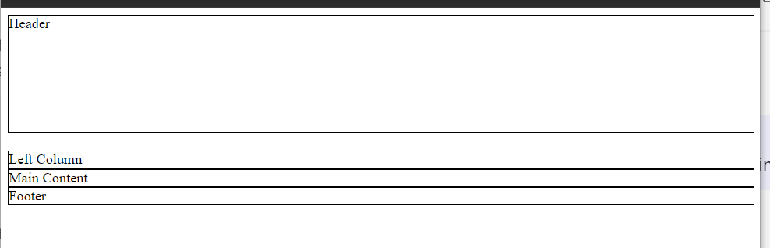
Styling the header…

Slide 30
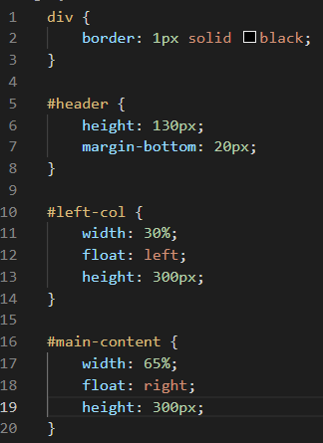
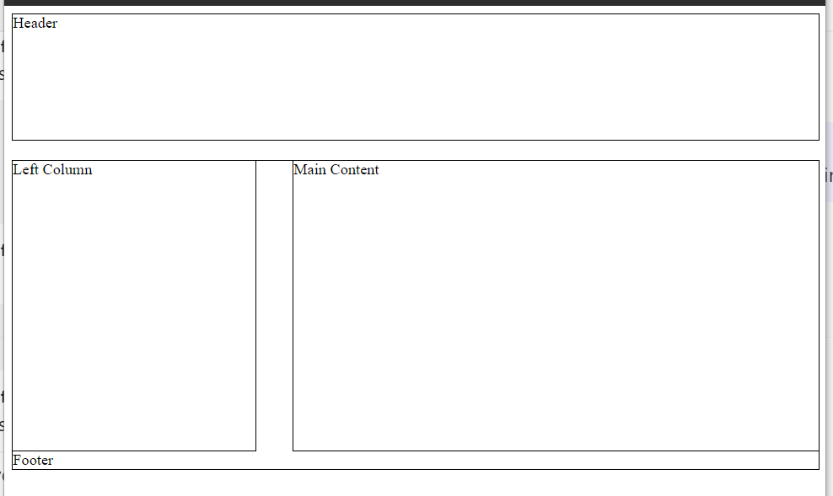
Styling the left column and content…

Slide 31
Styling the left column and content…
Because they are “floating”, they appear inside of the footer

Slide 32
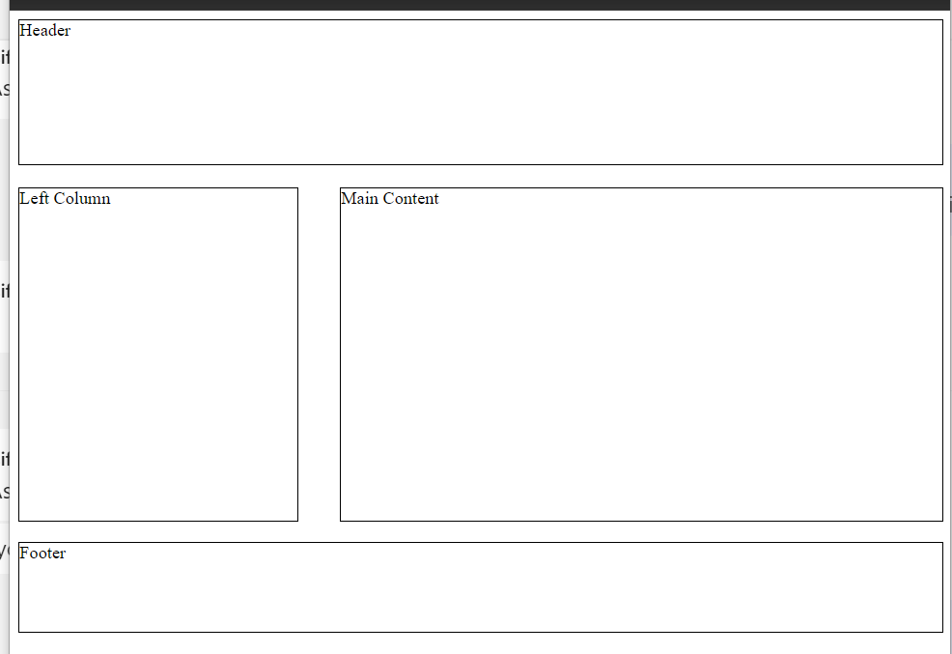
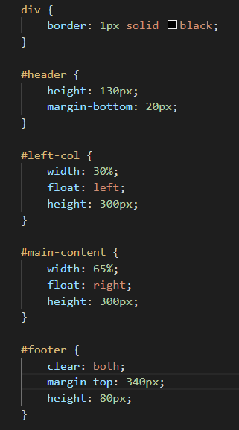
Styling the footer…

Slide 33
Styling the footer…
Why a top margin of 340px?

Slide 34
Only a quick start
CSS has been developed as a full-fledged programming environment for web applications
Web applications require a user interface
making CSS development more complex
We have another 1.5 weeks to explore it in details

Slide 35
Summary
HTML forms – important
Have a feeling of CSS – styling and layout
We will explore CSS in details next week

Slide 36
Sources
https://www.w3schools.com/html/
https://www.w3schools.com/css

